Slide 1
Fooling and Protecting Deep learning models
Divyam Madaan
Twitter: @divyam3897
Github: @divyam3897

Slide 2

About me
Final year undergraduate
Open source enthusiast
Deep Learning Researcher at FOR.ai

Slide 3
Agenda
Machine learning and Deep learning overview
Attacks on machine learning pipeline
Types of attacks
Timeline of machine learning security
Defending the machines

Slide 4
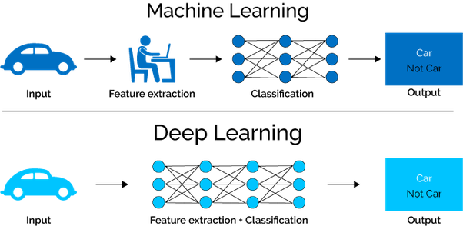
Machine learning vs Deep learning

Slide 5



Reached state of the art on various tasks

Slide 6

Good models make mistakes

Slide 7
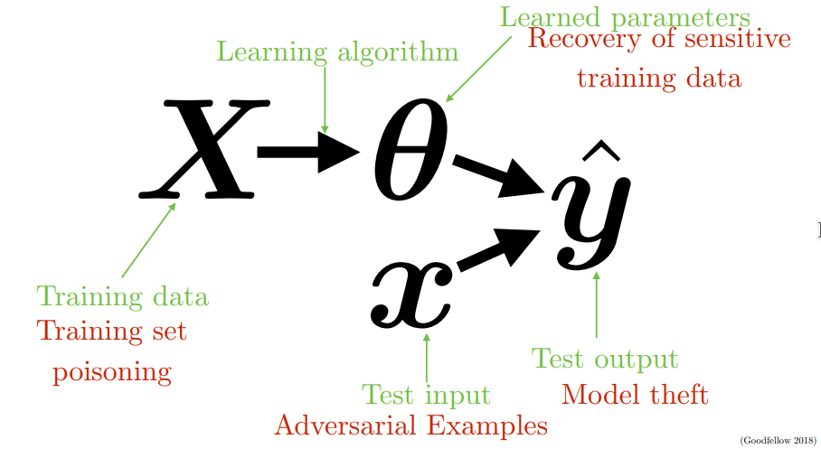
Attack on the machine learning pipeline

Slide 8
Types of Attacks

Slide 9
White box Attacks

Slide 10
Black box attacks

Slide 11
Targeted Attacks

Slide 12
Untargeted Attacks

Slide 13
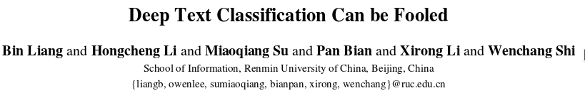
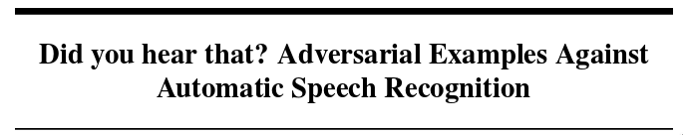
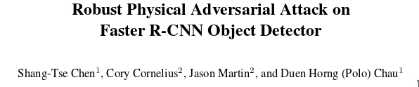
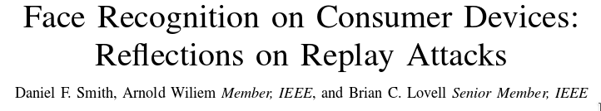
Not just images!

Slide 14
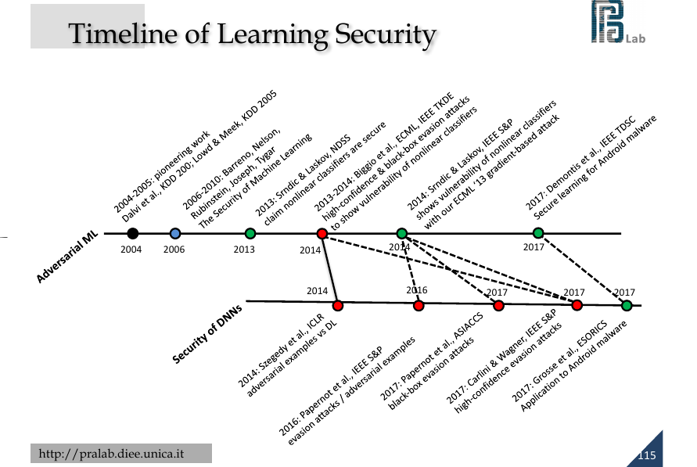

Slide 15
What this means for us?
Deep learning algorithms (Machine learning in general) are susceptible to attacks.
Use with caution in critical deployments
Spend effort to make model robust to tempering
Evaluate a model’s adversarial resilience - not just accuracy/precision/recal.

Slide 16
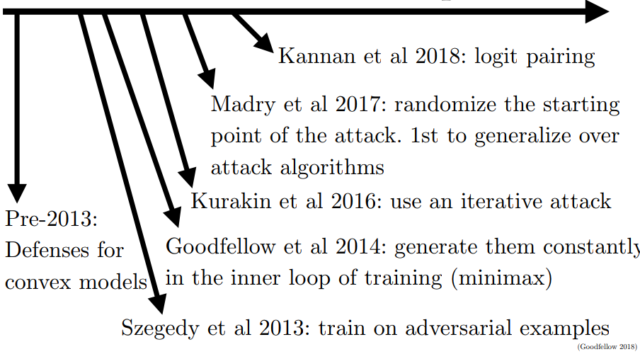
Defending the machines

Slide 17


Slide 18
Resources
Breaking Linear classifiers with convnets - Andrej Karpathy
Attacking machine learning with adversarial examples - Open AI
Adversarial Examples and adversarial training - Ian Goodfellow
Adversarial examples in machine learning - Ian Goodfellow
ICCV Tutorial on machine learning - Battista Biggio and Fabio Roli
Cleverhans

Slide 19
Thank you
Questions?
Twitter: @divyam3897
Linkedin: https://www.linkedin.com/in/dmadaan3897
Github: @divyam3897

